Slide 1
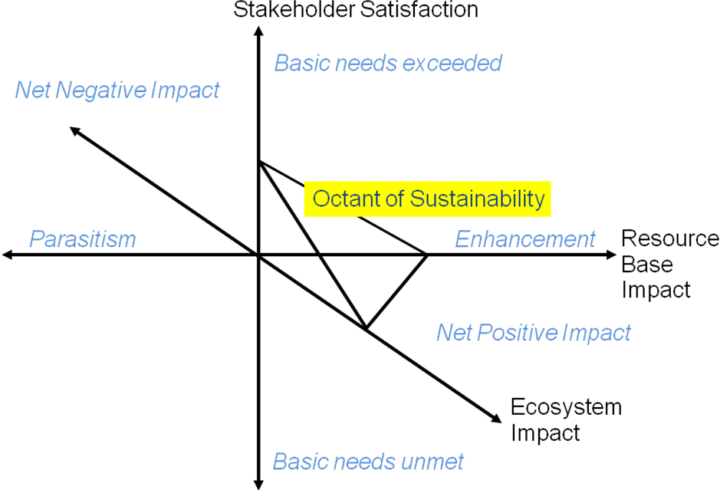
Systems Engineering with Economics, Probability and Statistics, Second Edition
By C. Jotin Khisty, Jamshid Mohammadi and Adjo A. Amekudzi
Figure 14.2 Triaxial Representation of Technological Sustainability
(Adapted from Pearce and Vanegas, 2002)

