Slide 1
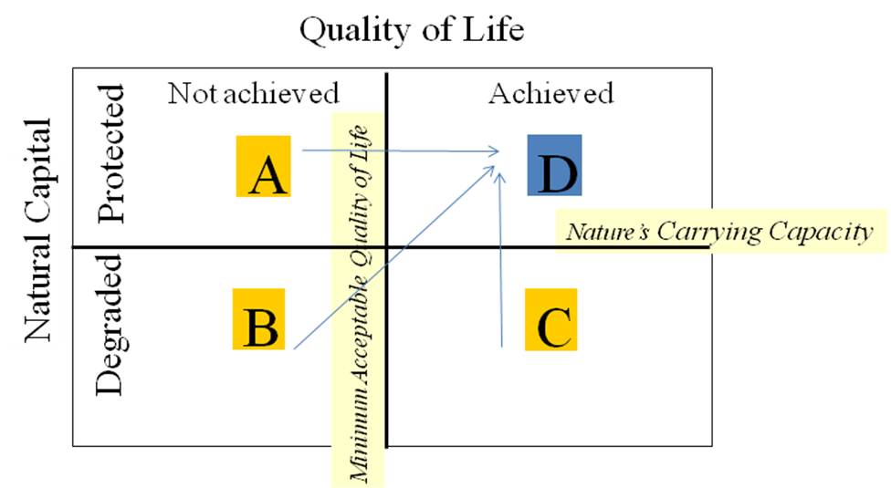
Systems Engineering with Economics, Probability and Statistics, Second Edition
By C. Jotin Khisty, Jamshid Mohammadi and Adjo A. Amekudzi
Figure 14.3 Quality of Life/Natural Capital Model
(Adapted from Chambers et al., 2000)

