Slide 1
PROGRAM PRESENTATION
DIRECT
ACCOUNTABILITY
NAIAD Company Ltd 2017. All rights reserved
www.naiad.ca

Slide 2
1. The Point
2. Concepts

Slide 3
1. THE POINT
Hail or Nail
NAIAD Company Ltd 2017. All rights reserved
www.naiad.ca

Slide 4
”
The ancient Romans had a tradition for their engineers. Whoever built an arch, the engineer had to stand beneath it while the capstone was put in place. That is how Romans defined accountability.

Slide 5
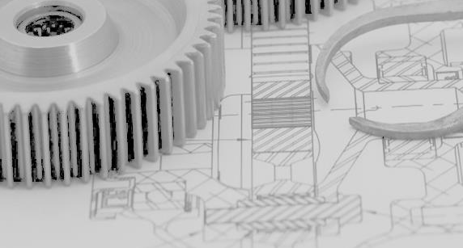
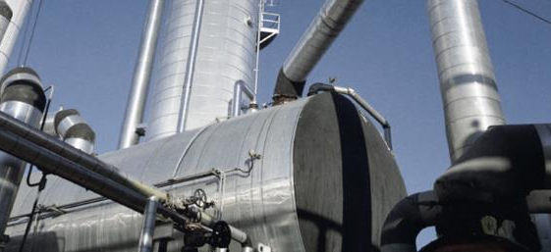
What it is
The path of attribution of merit or blame for an outcome
WHY?
Projects fail when dabblers are allowed to interfere. Dabblers matter because they can wreak havoc on projects. They meddle and prattle where analysis and acumen are called for. The live by three principles: FOE (Finance One’s Existence), JOE (Justify One’s Existence) and MOE (Maintain One’s Existence).
THE POINT
Success demands focused decision-making. Dabbling dies where direct accountability prevails. A person is accountable when he/she can be rewarded for successes or blamed for failures. Groups, departments and organizations cannot be made accountable. Only individuals.
The effect
Efficacy of execution management. Projects will be successful when genuine accountability governs. It yields the most effective organizing principle for staffing a project with the smallest staff count.
The conditions
Accountability implies three conditions. 1) The person’s decision determines the success of failure of an outcome; 2) The person can be hailed or nailed for an outcome’ and 3) The person will directly live with the consequences from the decision.

Slide 6
2. CONCEPTS
The nature of accountability

Slide 7
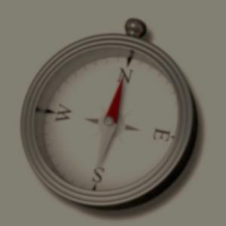
A new distinction
Accountability, responsibility and authority are distinct.
Accountable Party (AP)
The power vested upon an individual to execute a UTP
The AP owns what goes on inside the UTP
The AP defines what output must be generated
Specifies the transformation mechanisms required to produce the outputs
Specifies the inputs needed by the transformation; and
Identifies the enablers required to execute the activity
Responsible Party (RP)
The mandate assigned to an individual to marshal the resources required to execute the UTP
The RP lines up what is required to carry out the work
Supplies the UTP’s attributes, the targets and the enablers (project information, tools, processes, procedures and appropriately trained personnel)
Probate Party (PP)
The authority and power to approve the outputs of a UTP
D defines the limits, the constraints, and the output acceptance criteria
Certifies the correctness of the outputs and UTP characteristics before moving on to the next UTP
Verifies the compliance of the outcome against the constraints imposed upon the work
Once the PP has signaled approval, the RP accepts the metrics and records them
NAIAD Company Ltd 2017. All rights reserved
www.naiad.ca

Slide 8
The Directrix
AP, RP and PP made into a team
The directrix runs counter to the widely-held view in management circles that accountability is everybody’s business. The opposite holds: when everyone is in charge, nobody is.
The exclusion principle states that, for any given UTP, there most correspond one and only one person assigned to each role of the directrix. Furthermore, no AP can be PP for his own outputs
NAIAD Company Ltd 2017. All rights reserved
www.naiad.ca

Slide 9
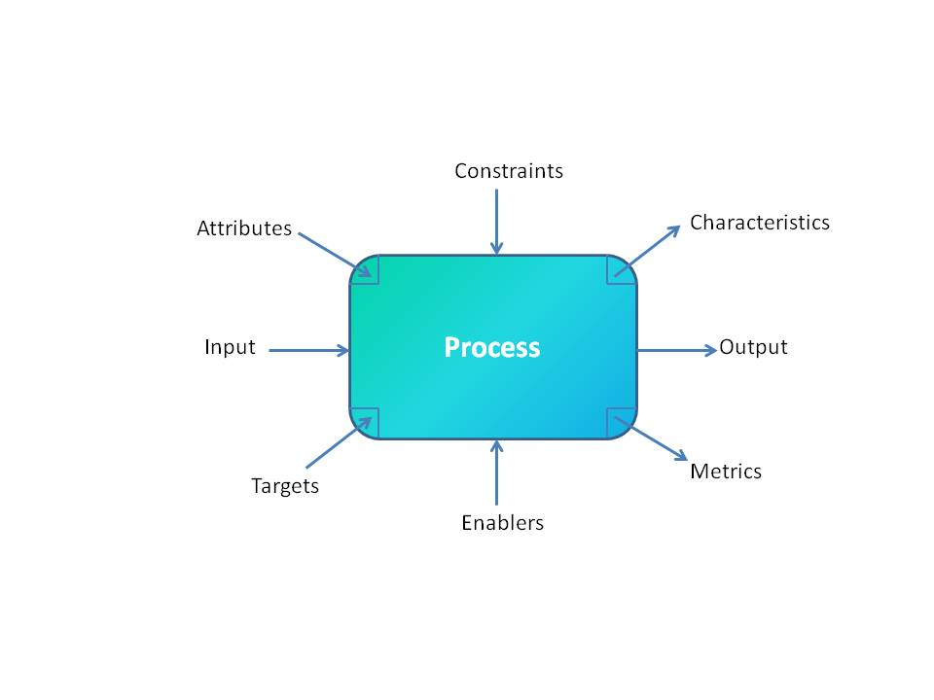
Relation to the UTP
Unit Transformation Process (UTP)
The UTP runs a set of inputs through a process to produce one or more outputs
Attributes are qualifiers to be embedded into the output (a part number for eg.)
Targets quantify the execution of the activity
Characteristics are derived from the contents of the output (eg. quantities)
Metrics are progress actuals vs targets
Enablers are supplied by the organization to execute the activity
Constraints bound the work
NAIAD Company Ltd 2017. All rights reserved
www.naiad.ca

Slide 10
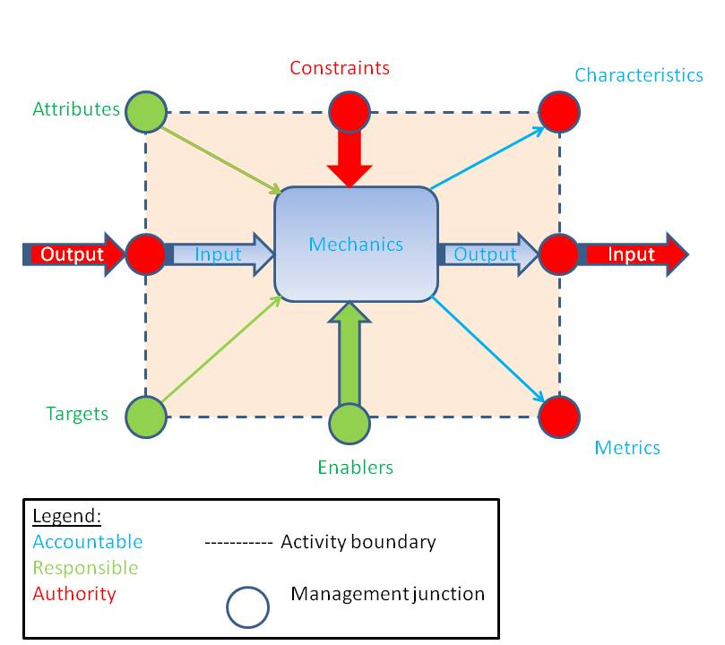
THE Directrix-UTP structure
Direct Accountability and Directrix
Direct Accountability is the path of attribution of merit or blame. Creates distinctions between parties that are accountable, responsible and that approve
The accountable party (AP) gets the work done
The responsible party (PP) provides the resources to the AP needed by the work
The probate party (PP) is given the authority to approve an output before it is passed on to the next UTP
The AP and PP are always separate
Together, the AP, RP and PP form the Directrix
AP, RP and PP mandates are assigned to individuals, never to groups
The execution of the work is managed at the interfaces between adjoining UTPs
NAIAD Company Ltd 2017. All rights reserved
www.naiad.ca

Slide 11
Organizing principle
All organizational charts are erected upon direct accountability
The separation of the roles among the AP, PP and RP is a characteristic of the execution of an activity. At the level of the project hierarchy, the project team is built based on the AP roles. In effect, the organization chart networks the AP roles as a decision hierarchy. The PP and RP will not, in general, appear as functional boxes in the organization chart; they are individual task assignments.
Paradoxically, each role will include elements of the other two in the daily execution of its mandate. For example, the AP for a given activity is responsible for orchestrating the enablers provided by the RP, and has the authority to deploy the enablers to execute the work within the defined constraints. The RP is accountable for the timely allocation of the enablers requested by the AP (as well as the suitability, adequacy and sufficiency of those enablers). The RP has the authority to mobilize those enablers unto the activity. The PP is accountable for defining the applicable constraints for the activity, and for the verification of outputs accordingly.
NAIAD Company Ltd 2017. All rights reserved
www.naiad.ca

Slide 12
Organizing principle
How to build a hierarchy of project personnel
The separation of the roles among the AP, PP and RP is a characteristic of the execution of an activity
The organizational chart of a project is built upon the AP roles. In effect, the organization chart networks the AP roles as a decision hierarchy
The PP and RP will not, in general, appear as functional boxes in the organization chart; they are individual task assignments
Paradoxically, each role will include elements of the other two in the daily execution of its mandate

