Slide 1
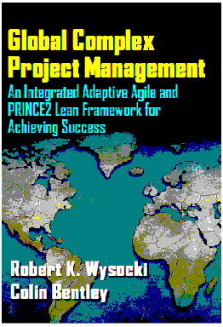
READ ME FIRST
P2 LEAN
PRINCE2 has been an unqualified success in the UK and EU and related geographies. It is just now beginning to take hold in the U.S.
But there is a problem. PRINCE2 was designed for the traditional linear project management project. Approximately 80% of projects are complex and very non-linear. There are many unknown unknowns and despite recent attempts to the contrary PRINCE2 does not work in these situations.
But now there is a solution. This slide deck is an extraction of topics from the book that focus on the 7 artifacts that we have taken from the ECPM Framework and integrated into PRINCE2. P2 LEAN is the solution we are offering the P2 community.
Thanks for your interest. Enjoy and please stay in touch! If you need additional information, just ask.
Notes:
Facilitator Notes
3 minutes
Discussion Points
This is your time to introduce yourself before the attendees introduce themselves.

Slide 2
Global Complex Project Management
An Integrated Adaptive Agile and PRINCE2
Lean Framework for Achieving Success
P2 LEAN Benefits Statement
Presented by
Robert K. Wysocki, PhD
President, EII Publications, LLC

Slide 3
Why this Book?
Introduction
PRINCE2 was originally designed for a linear project management landscape
ECPM was designed to accommodate complex project situations
PRINCE2 is not a Lean Process
ECPM is a Lean Framework
There are several artifacts from ECPM that can be easily adapted into PRINCE2 to create a framework that is adaptive, agile and lean
This book fills that gap and delivers P2 LEAN as a significant framework for increased business value!
Notes:
Facilitator Notes
3 minutes
Discussion Points
This is your time to introduce yourself before the attendees introduce themselves.

Slide 4
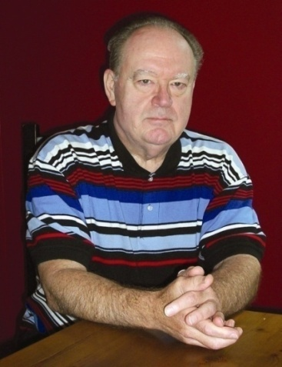
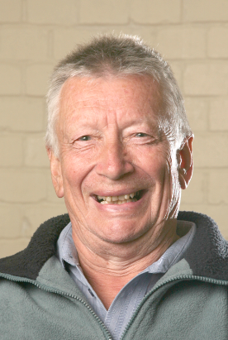
We are the Best Team for this Project!
Introduction
Robert K. Wysocki
President and founder of EII in 1991
Educator, Trainer, Consultant, Author
20 year career in higher education administration
25 year career as an international PM consultant
Designed ECPM from actual client engagements
Designed/Built/Deployed more than 20 PM courses
Author of 26 books on PM, BA and IT
Colin Bentley
46 years in PM
Joint author of the PROMPT II method
Original author of the PRINCE2 method
Chief Examiner for PRINCE2 from 96-09
Mentor for the 2009 re-write of PRINCE2
Wrote PM handbooks for the London Stock
Exchange, Microsoft Europe, ITSA and Tesco
Lectured in PM in Europe and Australia
Notes:
Facilitator Notes
3 minutes
Discussion Points
This is your time to introduce yourself before the attendees introduce themselves.

Slide 5
Table of Contents
Introduction
PART 1: OVERVIEW
Chapter 01: Introduction
Chapter 02: Overview of the ECPM Framework
Chapter 03: PRINCE2 Lean: Are you a Cook or a Chef?
Chapter 04: PRINCE2 Lean: Project Planning
PART 2: PRINCE2 AND THE IDEATION PHASE
Chapter 05: Prepare the Business Case Overview
Chapter 06: Creating the Project Product Description
Chapter 07: Preparing for the Initiation Stage
PART 3: PRINCE2 AND THE SET-UP PHASE
Chapter 08:Selecting the Project Core Team
Chapter 09: Designing the Project Approach
Chapter 10: Preparing the Project Initiation Documentation
PART 4: PRINCE2 AND THE EXECUTION PHASE
Chapter 11: Preparing for the Next Stage
Chapter 12: Executing the Stage Plan
Chapter 13: Closing the Stage
Chapter 14 Closing the Project
PART 5: PUTTING IT ALL TOGETHER
Chapter 15: Organizational Infrastructure
Chapter 16: Benefits of the P2 Lean Framework
Notes:
Facilitator Notes
3 minutes
Discussion Points
This is your time to introduce yourself before the attendees introduce themselves.

Slide 6
Benefits of Adopting this Book:
P2 LEAN is compatible with existing PRINCE2 environments
P2 LEAN easily integrates into an existing PRINCE2 environment
The artifacts recommended from the ECPM Framework can be selected as needed and further adapted to an existing PRINCE2 environment
P2 LEAN improves project performance and increases the delivery of business value
Notes:
Facilitator Notes
3 minutes
Discussion Points
This is your time to introduce yourself before the attendees introduce themselves.

Slide 7

Who Will Benefit from this Book?
Practitioner Teams
Have a model that allows you to align project management processes to your strategic plan
Know how PRINCE2 can increase the business value of your organization’s project portfolios
Have taken the first step to defining your own PRINCE2 agile and lean environment
Professional Services Firms and Consultant Teams
Have a new tool to generate business value
Educators/Trainers
Have a learning package to create courses for your degree and certificate programs
Notes:
Explain how each of these contributes to the growing importance of project management in the business world.

Slide 8
Basic Assumptions of the ECPM and GCPM
Introduction
Projects are unique and dynamic
The most effective project management process for a unique project will also be unique
The most effective project managers are those who can choose and adapt their management processes to these unique and dynamic conditions
These conditions include the characteristics of the project itself, the internal organization culture and environment and the dynamic market conditions
Notes:
Explain how each of these contributes to the growing importance of project management in the business world.

Slide 9
Presentation Agenda
Introduction
Overview and alignment of the P2 and ECPM Frameworks
ECPM Artifacts and the P2 LEAN Framework:
Co-Manager Model
High-level Requirements Definition
Scope Triangle
Bundled Change Request Process
Scope Bank
Probative and Integrative Swim Lanes
Vetted portfolio of tools, templates and processes
Brainstorming
P2 LEAN Planning Process
The P2 LEAN Project Support Office
Benefits from the P2 LEAN Framework
Notes:
Explain how each of these contributes to the growing importance of project management in the business world.

Slide 10
Effective PM Framework
What is the P2 LEAN Framework?
Definition: P2 LEAN Framework
The P2 LEAN Framework is an integration of selected artifacts from the ECPM Framework into the P2 Framework in order to create not just an agile and lean version of P2, but a better framework for handling complexity and uncertainty in projects:
(P2 + ECPM) Frameworks = P2 LEAN Framework
P2 LEAN is unique and our recommendation for a solution to the systemic high failure rate in the complex project landscape!

Slide 11
Effective PM Framework
P2 and ECPM Framework Comparisons
P2 is not a “one size fits all” solution. Rather, it is a flexible framework that can readily be tailored to any type or size of project.
ECPM is not a methodology. Rather, it is an adaptive agile framework that utilizes robust decision processes to build best-fit management models driven by project characteristics and the internal/external environments in which a project is executed.
The design similarities will allow for beneficial process sharing across the frameworks

Slide 12
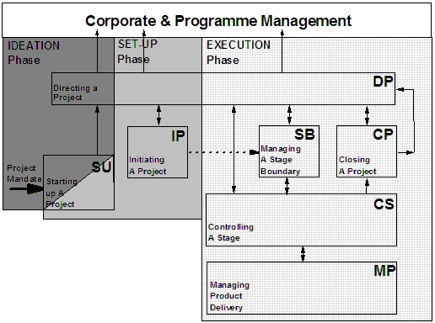
PRINCE2 and ECPM Framework Similarities
Framework Overlays–P2 and ECPM are Aligned

Slide 13
PRINCE2 and ECPM Framework Similarities
PRINCE2 Principles
Continued
Business
Justification
Defined Roles
and
Responsibilities
Focus
on
Products
Manage
by
Stages
Manage
by
Exception
Learn from
Experience
Tailor to Suit
the Project
Environment
PRINCE2
Principles

Slide 14
PRINCE2 and ECPM Framework Similarities
The ECPM Framework Aligns to the PRINCE2 Principles
The Business Case drives all 3 phases of the ECPM Framework:
IDEATION uses a customized brainstorming session to define a number of possible projects to address the Project Mandate.
Continued Business Justification
SET-UP designs the best fit project management approach using a vetted portfolio of tools, templates and processes.
EXECUTION conducts the project using the designed model subject to changes due to the dynamics of the situation
The Business Case is the control tool

Slide 15
PRINCE2 and ECPM Framework Similarities
The ECPM Framework Aligns to the PRINCE2 Principles
The ECPM Framework is built upon a shared management model.
Each ECPM project has two project managers. One is from the developer side (the P2 Supplier), the other is from the client side (the Business and or User side).
Defined Roles and Responsibilities
These co-managers have equal responsibility an authority as decision makers over the project.

Slide 16
PRINCE2 and ECPM Framework Similarities
The ECPM Framework Aligns to the PRINCE2 Principles
The high-level requirements include performance criteria that define product quality. These are documented in the Business Case and are in Client Checkpoint (similar to the end stage assessment).
Focus
on
Products
Process quality is monitored and assessed through a continuous process improvement program that is built into the ECPM Framework.

Slide 17
PRINCE2 and ECPM Framework Similarities
The ECPM Framework Aligns to the PRINCE2 Principles
ECPM complex projects require an adaptive approach built upon the learning and discovery that occurs through repeated Cycles (P2 Stages).
At the completion of each Cycle a Client Checkpoint is conducted to decide how the project should go forward, if at all. The client checkpoint is similar in many respects to the end stage assessments in P2.
The decision criterion aligns with the requirements and success criteria as specified in the Business Case and Project Overview Statement (POS). The POS is much like the Project Brief.
Manage
by
Stages

Slide 18
PRINCE2 and ECPM Framework Similarities
The ECPM Framework Aligns to the PRINCE2 Principles
The Client Checkpoint takes all previous project results into account and adapts Cycle plans and overall Project Plan as appropriate.
As such there is no separation of management by exception. It is absorbed into the normal conduct of the project's business, and is similar to the P2 End Stage Reports.
Manage
by
Exception

Slide 19
PRINCE2 and ECPM Framework Similarities
The ECPM Framework Aligns to the PRINCE2 Principles
Learn
From
Experience
ECPM Framework cycles (equivalent to P2 Stages) include Probative Swim Lanes which are experiments to learn AND discover solution components using lean practices.

Slide 20
PRINCE2 and ECPM Framework Similarities
The ECPM Framework Aligns to the PRINCE2 Principles
The ECPM Framework SET-UP Phase is a critical process. It establishes a customized version of the PMLC tailored to the project characteristics, the internal organizational environment and the external market conditions. That is unique with the ECPM Framework.
Tailor to Suit the Project Environment

Slide 21
PRINCE2 and ECPM Framework Similarities
PRINCE2 Themes
Business
Case
Organization
Quality
Plans
Risk
Change
Progress
PRINCE2
Themes

Slide 22
PRINCE2 and ECPM Framework Similarities
The ECPM Framework Aligns to the PRINCE2 Themes
A thorough business case is written during the IDEATION Phase. It is the thread that runs through the project life span and is used to decide on the future course of the project and how the business value delivered aligns with the expected business value.
Business
Case

Slide 23
PRINCE2 and ECPM Framework Similarities
The ECPM Framework Aligns to the PRINCE2 Themes
The ECPM Framework uses an advisory Project Review Board. The Project Review Board members are the senior managers who have a functional connection with the project and a few senior project managers who have no vested interest in the project.
On a periodic basis the project co-managers appear before the Project Review Board to report on the progress of their project since the last review.
Organization

Slide 24
PRINCE2 and ECPM Framework Similarities
The ECPM Framework Aligns to the PRINCE2 Themes
In any ECPM project there are two types of quality – product quality and process quality. The developer team is responsible for performing up to the level of the processes available and delivering the product quality as specified in the high-level requirements. The client team is responsible for assuring that the product quality does measure up to expectations.
Quality

Slide 25
PRINCE2 and ECPM Framework Similarities
The ECPM Framework Aligns to the PRINCE2 Themes
In the ECPM Framework the journey to the learning and discovery of the solution proceeds through a series of cycle plans (In P2 these are Stage Plans).
These cycle plans are dependent upon each other in the sense that the output from a cycle plan is input to the next cycle plan. An overall project plan exists only at a high level and describes generally how the project team expects the project to proceed. As learning and discovery takes place the overall project plan is often revised due to revisions in the scope of the project. At this level both P2 and the ECPM are equivalent and P2 LEAN simply accommodates both.
Plans

Slide 26
PRINCE2 and ECPM Framework Similarities
The ECPM Framework Aligns to the PRINCE2 Themes
Complex projects are high risk projects. A sound risk management plan is included in P2 and P2 Lean - except P2 LEAN assigns a team member to be responsible for keeping the risk plan updated and keep the team members informed all project risks, their status and any other updates. P2 would normally assign maintenance of the Risk Register to Project Support, but as this is a role, the role may be allocated to a team member.
Risk

Slide 27
PRINCE2 and ECPM Framework Similarities
The ECPM Framework Aligns to the PRINCE2 Themes
ECPM Framework uses its own bundled change management process. Change requests are held in the Scope Bank until the cycle ends. As part of planning for the next cycle those change requests are each decided upon as part of a group rather than individually.
Change

Slide 28
PRINCE2 and ECPM Framework Similarities
The ECPM Framework Aligns to the PRINCE2 Themes
In the ECPM Framework progress is measured as actual performance against planned performance and this is tracked over time. This primitive Earned Value Analysis (EVA) can be used to track trends that are indicative of convergence towards or divergence from an acceptable solution.
Progress

Slide 29
PRINCE2 and ECPM Framework Similarities
What Does All of this Mean?
The similarities between process diagrams, principles and themes will be an advantage as we adapt tools, templates and processes from one framework to another. Here we focus on integrating ECPM into PRINCE2 with significant benefit to PRINCE2.

Slide 30
Creating the P2 LEAN Framework
Recommended ECPM Framework Artifacts
The ECPM artifacts that we recommend integrating into P2 are:
Co-Manager Model
High-level Requirements Elicitation
Scope Triangle
Bundled Change Request Process
Scope Bank
Probative and Integrative Swim Lanes
Vetted portfolio of tools, templates and processes

Slide 31
Co-Manager Model
The Importance of Meaningful Client Involvement
For several years now the Standish Group has reported on the importance of client involvement to the success of projects. This is a critical success factor and is a design feature of the ECPM Framework.
“It takes a village” to successfully deliver business value from a complex project.

Slide 32
Co-Manager Model
ECPM Advocates Meaningful Involvement of the Client
Notes:
Like all well planned presentations we are going to tell you what we are going to tell you, tell you and then tell you what we told you.
So let’s spend some time telling you what we are going to tell you.
Some basic logistics first:
This course is interactive.
Ask questions
Challenge what you hear
Engage the instructor in applications at your company
What works?
What doesn’t work?
Spend a few minutes on each topic to give them a sense of what the course is about.

Slide 33
Co-Manager Model
The Client and the Project Manager Relationship
To create ownership by the client they must be meaningfully involved throughout the entire project
A Co-manager partnership with the client is the most effective way to create client ownership of the solution
Establishing that partnership has had a successful history in the ECPM Framework

Slide 34
Co-Manager Model
A Practical Model for Meaningful Client Involvement
What if the client team doesn’t understand ECPM?
What if you can’t get the client to be meaningfully involved?
What if the client is hesitant to get involved?
What if the client wants to get too involved?

Slide 35
Co-Manager Model
Challenges to Attaining & Sustaining Involvement
Always use the language of the client
Maintain a continuous brainstorming culture
Use the Co-Manager Model
Establish an open and honest team environment

Slide 36
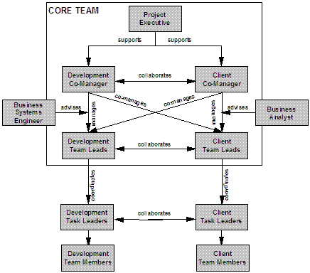
Co-Manager Model
The Complex Project Team is a Lean Structure
This structure centralizes and improves decision making within the team.

Slide 37
Co-Manager Model
Benefits to P2 LEAN Framework
Most process/product decisions can now be taken within the team itself. It Is lean because it reduces the non-value added work time preparing for a Project Board Review and decision.
Establishes meaningful client participation in the project
Establishes an ownership position on the part of the client and improves successful implementation of the deliverables
Improves the quality of decisions, Stage Planning and product quality

Slide 38
High-Level Requirements Elicitation
Define High-Level Requirements
A requirement is a desired end-state whose successful integration into the solution meets one or more needs,
and delivers to the organization:
  specific,
    measurable
      business value
The set of requirements forms a necessary and sufficient set for achieving expected business value.

Slide 39
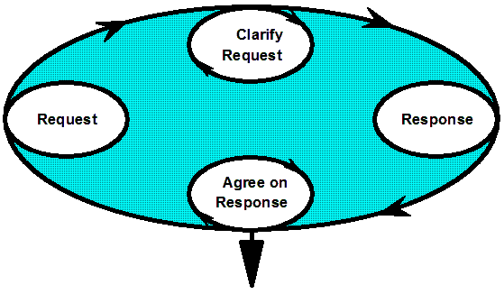
High-level Requirements Elicitation
Elicit Requirements – Conditions of Satisfaction
Negotiate Agreement and Write Overview Statement

Slide 40
High-level Requirements Elicitation
Upfront Elicitation of Complete Requirements is Rare
ECPM Requirement definition evolves as part of project execution. The definition takes the form of a hierarchical structure know as the Requirements Breakdown Structure (RBS). The hierarchy includes any or all of the following:
Sources of
solution unknowns
Functions and Sub-functions
Processes and Activities
Features
The specific evolution occurs as the product of iterative learning and discovery.

Slide 41
High-level Requirements Elicitation
Upfront Elicitation of Complete Requirements is Rare
The internal and external environments are dynamic:
Solutions are not clearly defined up front
Market conditions change without notice
Unpredictable actions of competitors
Technological advances
Client learning and discovery
Changing strategies and priorities
You can never know for sure that requirements are complete.
When in doubt, assume they are not complete.

Slide 42
High-level Requirements Elicitation
Elicit & Document Requirements
Reasons to Create the Requirements Breakdown Structure:
Most meaningful to the client
Promotes client ownership and buy-in of the solution
Deliverables-based and in the client’s comfort zone
Can be used to measure progress to the solution
Can be used to measure project status
Consistent with PMI PMBOK
Conventional wisdom says that a complete RBS is not possible at the start of a complex project.

Slide 43
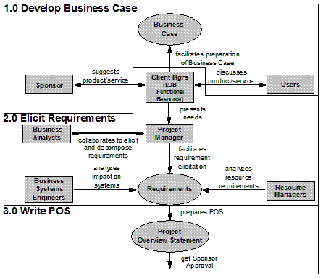
High-level Requirements Elicitation
Elicit Requirements

Slide 44
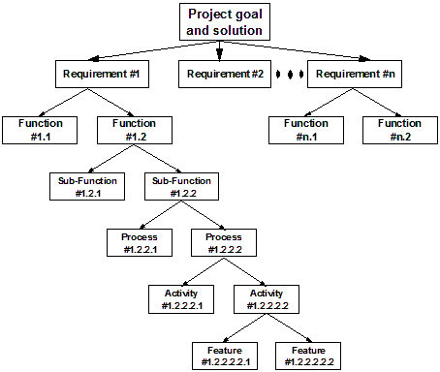
High-level Requirements Elicitation
Elicit Requirements–Requirements Breakdown Structure

Slide 45
High-level Requirements Elicitation
Elicit Requirements – Methods
Ranking of Preferred Methods for Eliciting Requirements:
Brainstorming
User Stories
Interviews
Facilitated Group Sessions
Prototyping
Requirements Workshop
Least Formal
Most Formal
Robertson, Suzanne & James Robertson, (2012). Mastering the Requirements Process, 3rd Edition, (Boston, MA: Addison-Wesley-Professional

Slide 46
High-level Requirements Elicitation
Elicit Requirements
Requirements Breakdown Structure (RBS)
The RBS is a hierarchical description of all of the ECPM requirements that must be present in the solution in order to deliver the business value expected.
The RBS hierarchical structure may include any or all of the following in this decomposition order:
  Functions
  Sub-functions
  Processes
  Activities
  Features

Slide 47
High-level Requirements Elicitation
Brainstorming
Strengths
Can identify ideas from others ideas
Weaknesses
Must control to avoid criticizing ideas

Slide 48
High-level Requirements Elicitation
User Stories
Strengths
State of system described before entering system
Scenarios used to describe state of system
Normal flow of event and exceptions revealed
Weaknesses
Newness has resulted in some inconsistencies
Information may still be missing from scenario
Long interaction required
Training expensive
Cohn, Mike (2004). User Stories Applied for Agile Software Development, (Boston, MA: Addison-Wesley)

Slide 49
High-level Requirements Elicitation
Interviews
Strengths
End user participation
High-level descriptions of functions and processes are provided
Weaknesses
Descriptions may differ from actual detailed activities
Without structure, stakeholders may not know what information to provide
Real needs may be ignored if the analyst is prejudiced
Cohn, Mike (2004). User Stories Applied for Agile Software Development, (Boston, MA: Addison-Wesley)

Slide 50
High-level Requirements Elicitation
Facilitated Group Sessions
Strengths
Excellent for cross-functional processes
Detailed requirements can be documented and verified immediately
Resolves issues with an impartial facilitator
Weaknesses
Use of untrained facilitators can lead to negative response from users
The time and cost of the planning and/or executing the session can be high

Slide 51
High-level Requirements Elicitation
Prototyping
Strengths
Innovative ideas can be generated
Users clarify what they want
Users identify requirements that may be missed
Client-focused
Early proof of concept
Stimulates thought processes
Weaknesses
Client may want to implement the prototype
Difficult to know when to stop
Specialized skills are required
Absence of documentation

Slide 52
High-level Requirements Elicitation
Requirements Workshop
Strengths
Good way for first time users
Weaknesses
May overwhelm the client

Slide 53
High-level Requirements Elicitation
Benefits to the P2 LEAN Framework
Requirements elicitation is a two-step process. The first step identifies the high-level requirements of an acceptable solution. These will not change.
All guessing about requirements is removed and relegated to the discovery through the Stages.
Through successive stages the lower level decomposition of the high-level requirements is discovered.
The project holds firmly to the client’s comfort zone and gives them a rationale for decision making about stage planning.
High-level requirements and their relationship to business value are the foundation of a P2 LEAN Project.

Slide 54
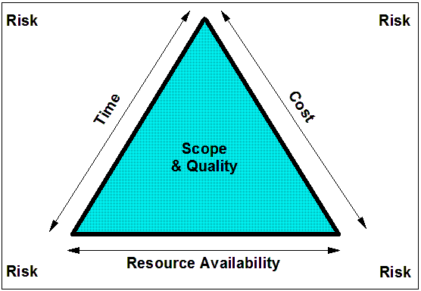
The Scope Triangle
The ECPM Scope Triangle – A System in Balance

Slide 55
The Scope Triangle
The ECPM Scope Triangle–Complex Project Realities
In a Complex Project Scope is Variable
Problem Resolution Strategy
Scope Change Impact Analysis

Slide 56
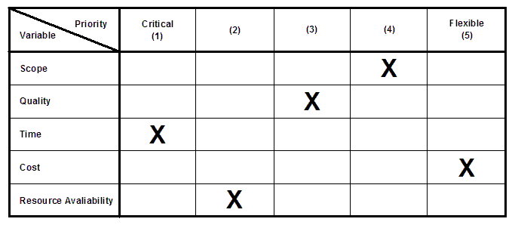
The Scope Triangle
The Complex Project Manager Position Family

Slide 57
The Scope Triangle
Benefits to the P2 LEAN Framework
The Scope Triangle replaces the Iron Triangle and provides a clearly understood system for problem solving, decision making and solution prioritization.
The Scope Triangle identifies who own what and offers a prioritization of the 5 factors for solution formulation and recommendations.

Slide 58
Bundled Change Request Process
Define Version Process
Submit change
request
Review
change
request
Reject
Rework & Resubmit
Accepted
The ACPF Change Process is a Bundled Process. Change requests are evaluated and prioritized during the Client Checkpoint.
Add change
request to
Scope Bank
At cycle completion
prioritize change
requests
Request impact study
for high priority
change requests
Analyze
impact study
Reject
Rework & Resubmit
Accepted
Select approved
changes for next
cycle plan

Slide 59
Bundled Change Request Process
Define Version Scope – Change Request
Project Name
Change Requested By
Date Change Requested
Description of Change
Business Justification
Action
Approved By
Date

Slide 60
Bundled Change Request Process
Benefits to the P2 LEAN Framework
Stage execution is not interrupted with change request processing.
Bundling change requests provides a holistic framework for making change decisions and scheduling them for deployment. This is a lean process.
Change requests are held in the Scope Bank to be considered during the next Stage Planning.
Bundling change requests allow for allocations to the most effective stages and lean application.

Slide 61
Scope Bank
Definition of the Scope Bank
The Scope Bank is the only depository of the ideas for improving the solution. It will contain the updated RBS, new functionality, processes, or features not yet added to the solution. All of the ideas for solution enhancement are held for further consideration and prioritization.
At any point in time, the Scope Bank will contain the following:
      List of learning and discovery from prior cycles
      Change requests not yet incorporated
      Current prioritized requirements
      The known RBS decomposition
      Prioritized Probative Swim Lanes not yet acted upon
      Prioritized Integrative Swim Lanes not yet acted upon

Slide 62
Scope Bank
The Scope Bank Contents
Scope Bank Contents:
List of learning and discovery from prior cycles
Change requests not yet incorporated
Current prioritized requirements
The known RBS decomposition
Prioritized Probative Swim Lanes not yet acted upon
Prioritized Integrative Swim Lanes not yet acted upon

Slide 63
Scope Bank
The Scope Bank – Contents Description
Scope Bank Contents Description:
ID
Date posted
Posted by (person’s name)
Brief description of the item
Projected business value (if appropriate)
Estimated duration to complete the item
Team comments on the item
Prioritization in appropriate swim lane

Slide 64
Scope Bank
Benefits to the P2 LEAN Framework
The Scope Bank is an historical record of the past, present and future of a P2 LEAN Project
The Scope Bank is the Knowledge Warehouse for the project and keeps all relevant information in front of the project team for their decision making requirements.
The Scope Bank assures that the project stays on track through the Stages.

Slide 65
Probative & Integrative Swim Lanes
Plan Next Stage
Types of Swim Lanes
Probative: These swim lanes are conducted for the purpose of learning and discovering parts of the solution
Integrative: These swim lanes are conducted to add newly discovered parts of the solution that emanated from previous probative swim lanes

Slide 66
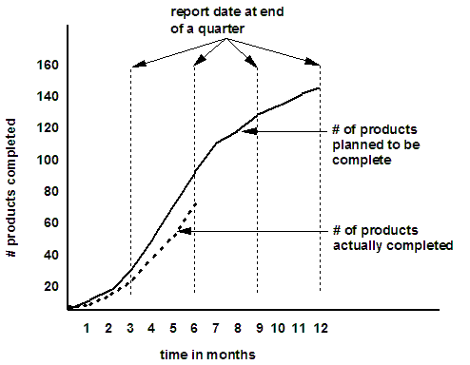
Probative & Integrative Swim Lanes
Primitive Earned Value Analysis

Slide 67
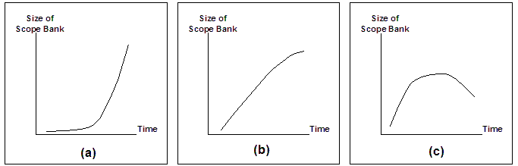
Probative & Integrative Swim Lanes
The Scope Bank Size Over Time

Slide 68
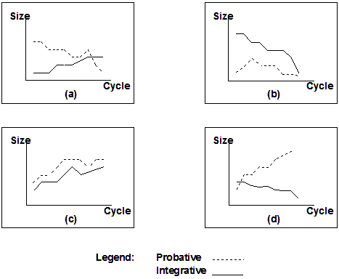
Probative & Integrative Swim Lanes
Comparative Changes in Swim Lane Sizes Over Time

Slide 69
Probative & Integrative Swim Lanes
Benefits to the P2 LEAN Framework
Requirements elicitation is a two-step process. The first step identifies the high-level requirements of an acceptable solution. These will not change.
Through successive stages the lower level decomposition of the high-level requirements is discovered.
All guessing about requirements is removed and relegated to the discovery through the stages.
The project holds firmly to the client’s comfort zone and gives them a rationale for decision making about stage planning.

Slide 70
Portfolio of Tools, Templates and Processes
P2 LEAN/kit
The P2 LEAN/kit are the vetted tools, templates and processes an organization uses to create and maintain models for the successful management of specific projects. It might contain:
Bodies of Knowledge
Portfolio of PMLC Models (including PRINCE2)
Vetted tools, templates and processes
Customized reports
Business process models
Process improvement program
Professional development program
Problem solving models
Decision making processes
RASCI Matrix

Slide 71

Portfolio of Tools, Templates and Processes
P2 LEAN/kit – The Chef’s Pantry
To manage a unique project, would you rather follow a recipe or know how to develop the recipe?

Slide 72
Portfolio of Tools, Templates and Processes
Assess Project Characteristics
Project Characteristics:
Risk | Complexity
Cost | Goal & Solution Clarity
Duration | Team Skills & Competencies
Completeness of Requirements
Internal Characteristics:
Business Value
Client Involvement
Organizational Stability
Organizational Velocity
# of Departments Affected
External Characteristics:
Market Stability
Business Climate
Competitor Behavior
Organizational Velocity
Breakthrough technologies

Slide 73
Portfolio of Tools, Templates and Processes
Determine Project Quadrant
Solution
Clear Not Clear
Extreme
Projects
(Q4)
Extreme
Projects
(Q3)
Traditional
Projects
(Q1)
Agile
Projects
(Q2)
Not Clear
Goal
Clear

Slide 74
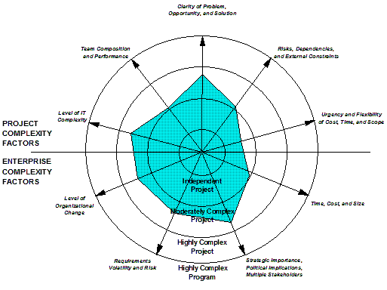
Portfolio of Tools, Templates and Processes
What is a Complex Project?
This project is
Moderately Complex

Slide 75
Portfolio of Tools, Templates and Processes
Determine Project Quadrant
Solution
Clear Not Clear
Complex
Project
Landscape
Not Clear
Goal
Clear
Emertxe
Projects
(Q4)
Extreme
Projects
(Q3)
Traditional
Projects
(Q1)
Agile
Projects
(Q2)

Slide 76
Portfolio of Tools, Templates and Processes
Determine Project Management Model
Solution
Clear Not Clear
MPx
Extreme
INSPIRE
xPM
Extreme
INSPIRE
Not Clear
Goal
Clear
TPM
Linear
Standard Waterfall
Rapid Dev Waterfall
Incremental
Staged Del Waterfall
FDD
APM
Iterative
Prototyping
Evol. Dev.Waterfall
RUP
DSDM
ASD
Scrum
Adaptive
ECPM Execution Phase
PRINCE2

Slide 77
Portfolio of Tools, Templates and Processes
Benefits to the P2 LEAN Framework
P2 LEAN gives the Project Co-Managers the flexibility to choose the tools, templates and processes they will use and adapt to manage their project.
As the project progresses through the stages the P2 LEAN kit is a resource for maintaining alignment of the management to the changing needs of the project.

Slide 78
Supporting the P2 LEAN Framework
Other Artifacts for Supporting P2 LEAN
Brainstorming Process
P2 LEAN Planning Hierarchy
Project Support Office (PSO)
Benefits from the P2 LEAN Framework
Notes:
Facilitator Notes
3 minutes
Discussion Points
This is your time to introduce yourself before the attendees introduce themselves.

Slide 79
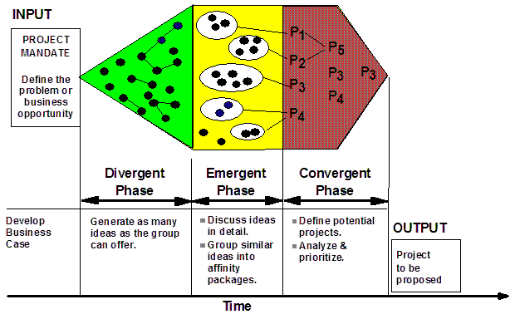
Brainstorming
The P2 LEAN Brainstorming Process

Slide 80
Brainstorming
The P2 LEAN Brainstorming Process
The P2 LEAN Brainstorming Process is a robust process that has been designed so it applies across the entire Framework for the:
Business Case Formulation
Requirements Elicitation
Problem-Solving
Swim Lane Planning
Stage Planning

Slide 81
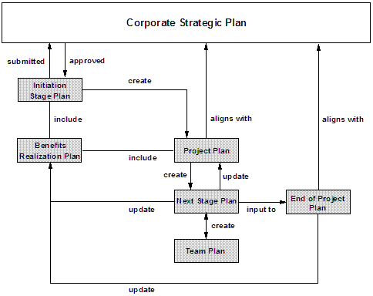
Planning
The P2 LEAN Planning Hierarchy

Slide 82
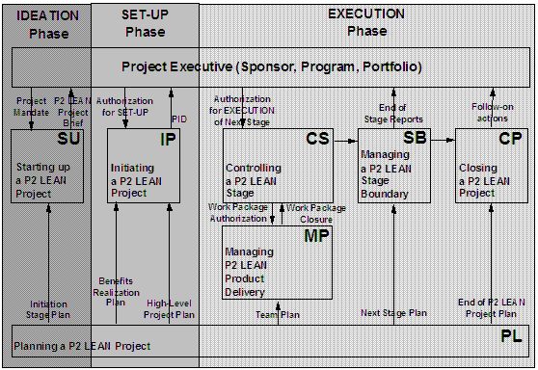
Planning
In P2 LEAN Planning is a Process Not a Theme

Slide 83
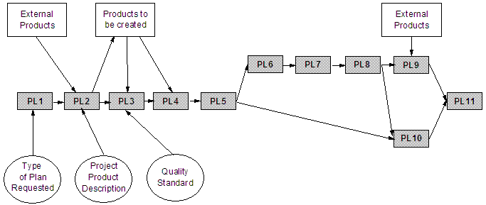
Planning
The Complex Project Landscape

Slide 84
Planning
P2 LEAN Planning Characteristics
P2 LEAN Planning is:
Pervasive
Just-in-Time
Product-based
Lean

Slide 85
Planning
Conduct Client Checkpoint
CAUTION
The Client Checkpoint is a critical part of a successful P2 LEAN Project. It must be taken seriously and conducted in an open and honest environment. Leave your politics and power at the doorstep.
INPUT DATA
Planned vs. Actual deliverables
Learning and Discovery
Probative swim lane results
Updated Scope Bank
Status reports
External environment
Internal environment
Updated RBS
OUTPUT DATA
Re-prioritized integrative swim lanes
Re-prioritized probative swim lanes
Next cycle duration
Next cycle content
PROCESS
Project Review
Is the Team working as expected?
Is the Client participating as expected?
Do cumulative deliverables meet expectations?
Is version scope still valid?
Prioritize remaining functionality
Brainstorm next cycle Swim Lane contents
PMLC Model adjustments

Slide 86
Planning
Plan Next Stage
First Stage Plan
Five directions for the first stage plan:
Project definition statement
Proof of concept
Build an iconic prototype of the desired solution
Build the current solution as it is known
Build from a prioritized list of functionality

Slide 87
Planning
Plan Next Stage
Second and Subsequent Stage Plans include:
Update the prioritized functionality list
Establish the contents of the next stage build integrative swim lanes
Establish the contents of the next stage build probative swim lanes
Create low-level WBS for the stage deliverables
Identify resource requirements
Estimate swim lane duration
Establish technical and resource dependencies
Finalize stage schedule

Slide 88
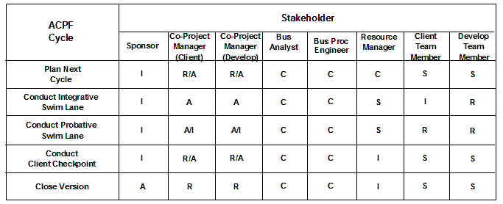
Planning
Plan Next Cycle – RASCI Matrix

Slide 89
Project Support Office (PSO)
Establish an Initial PSO
Form the PSO Task Force
Current State of Project Management
Desired End State of Project Management
How to get to the Desired End State
PSO Performance

Slide 90
Project Support Office (PSO)
Establish an Initial PSO
Form the PSO Task Force
NOTE:
The PSO Task Force is needed to define the current state and the desired end state of project management across the organization.

Slide 91
Project Support Office (PSO)
Establish an Initial PSO
What is the Current State of PM?
What are the future projects?
What are the needs of the future projects?
Is the vetted portfolio of tools, templates and processes aligned to the needs of future projects?
What is the future staff resource profile?
What is the expected gap between the current and future staff resource profile?
How should that gap be managed?

Slide 92
Project Support Office (PSO)
Establish an Initial PSO
What is the Desired End State of PM?
What are the future projects?
What are the needs of the future projects?
Is the vetted portfolio of tools, templates and processes aligned to the needs of future projects?
What is the future staff resource profile?
What is the expected gap between the current and future staff resource profile?
How should that gap be managed?

Slide 93
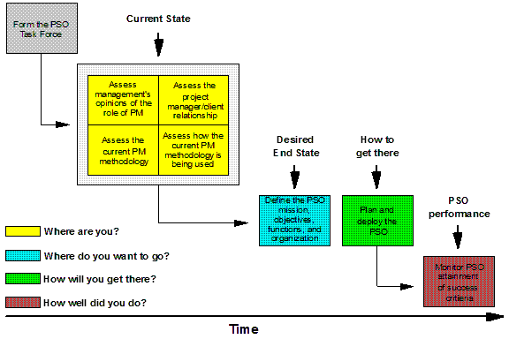
Project Support Office (PSO)
Establish an Initial PSO

Slide 94
Project Support Office (PSO)
Establish an Initial PSO
How to get to the Desired End State
Establish the Vision/Mission/Objectives
Select and prioritize the services to be offered
PSO Organizational Structure
PSO Staffing

Slide 95
Project Support Office (PSO)
Establish an Initial PSO
Establish Vision/Mission/Objectives of the PSO
VISION: To be a one-stop-support for P2 LEAN
MISSION: Maintain a portfolio of tools, templates and processes to support the project management needs for establishing a market leadership position
OBJECTIVES: Help the team deliver business value
Increase the project success rate to 75%
Reach CMMI Maturity Level 4

Slide 96
Project Support Office (PSO)
Establish an Initial PSO
Select and prioritize the services to be offered
Project Support
Consulting & Mentoring
Methods & Standards
Software Tools
Training Development & Delivery
Project Manager Development
Project Manager Assignment

Slide 97
Project Support Office (PSO)
Establish an Initial PSO
PSO Staffing
Temporary: This strategy rotates project managers through the PSO for assignments between projects
Permanent: These assignment are usually reserved for the most senior of project managers. Their role is more consulting than anything else.

Slide 98
Project Support Office (PSO)
Challenges to Implementing a PSO
Speed and Patience
Leadership from the Bottom Up
A Systems Thinking Perspective
Enterprise-wide Systems
Knowledge Management
Learning and Learned Project Organizations
Open Communications

Slide 99
Project Support Office (PSO)
Establish an Initial PSO
PSO Performance
Executive Support
(Meaningful) User Involvement
Clear Business Objectives
Emotional Maturity
Optimizing Scope
Agile Process
Project Management expertise
Skilled Resources
(Adaptive) Execution
Tools & Infrastructure

Slide 100
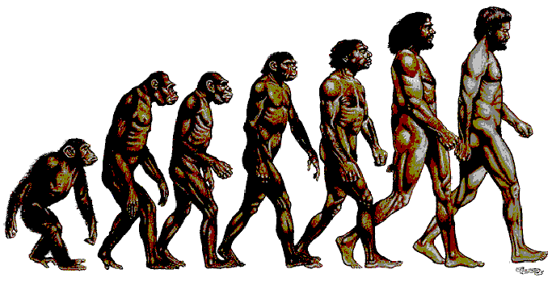
Project Support Office (PSO)
Mature the Initial PSO to a P2 LEAN PSO
Agile Project Portfolio Management (APPM) process
Complex Project Manager (CPM) position family
Career & Professional Development Program
Project Review Process

Slide 101
Project Support Office (PSO)
Mature the Initial PSO to a P2 LEAN PSO
Career & Professional Development Program
Process
Director
Practice
Director
Senior
Consultant
Manager
Consultant
Associate
Manager
Senior
Project Manager
Project Manager
Associate
Project Manager
Team Leader
Team Member

Slide 102
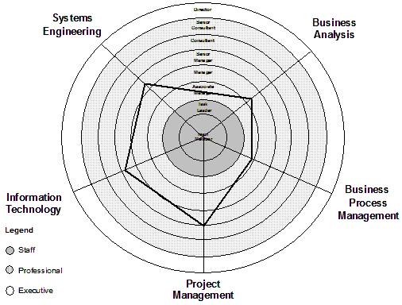
Project Support Office (PSO)
Mature the Initial PSO to a P2 LEAN PSO

Slide 103
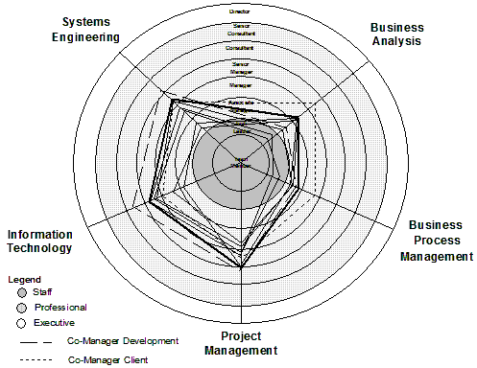
Project Support Office (PSO)
Mature the Initial PSO to a P2 LEAN PSO

Slide 104
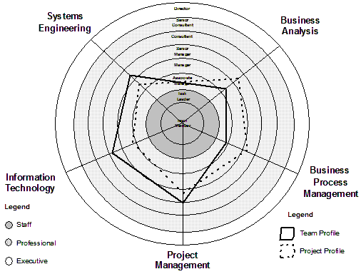
Project Support Office (PSO)
Mature the Initial PSO to a P2 LEAN PSO

Slide 105
Benefits Realization from the P2 LEAN Framework
Business Value and the P2 LEAN Framework
The purpose of a P2 LEAN Project is to generate the maximum business value possible within the time and budget constraints provided.
The structure and processes of a P2 LEAN Project are flexible and lean. The Co-Managers are authorized to decide how best to manage the project.
A P2 LEAN Project minimizes the non-value added work and documentation associated with producing the deliverables.
Decision making and problem solving in a P2 LEAN Project is done closest to the point of expertise about the situation.

Slide 106
ECPM Framework
Thanks for the opportunity!!!
Robert K. Wysocki, Ph.D.
rkw@eiicorp.com

