Slide 1
Shallow Foundations
- Bearing capacity and settlement
Duration = 12 minutes

Slide 2
Shallow Foundations
Shallow vs. Deep foundations
Bearing capacity
Settlement

Slide 3
Shallow and Deep Foundations

Slide 4
Foundations
To transfer the load from the super structure (e.g. Building) to the underlying soil, safely and economically.

Slide 5
Foundations
Q
Q
Column
GL
D_{f}
L
Foundation
B
B
Soil
D_{f}
Breadth =B; Length=L; and Depth =D_{f}
B is the shorter of B and L

Slide 6
Foundations
Q
Q
GL
Footing
D_{f}
B
Pile
(a) (b)
(a) Shallow foundations: D_{f} < B
(b) Deep foundations: D_{f} > B

Slide 7
Design Criteria
Two major considerations are:
No shear failure to take place within the surrounding soil – BEARING CAPACITY Consideration
Settlements to be within tolerable limits – SETTLEMENT Consideration

Slide 8
Types of Shallow Foundations
Q (kN)
L
B
D_{f}
Pad footing
Applied soil pressure:

Slide 9
Types of Shallow Foundations
Wall load: Q (kN/m)
L >> B
Strip footing
D_{f}
B
Applied soil pressure:

Slide 10
Types of Shallow Foundations
Raft or Mat foundation
Supports multiple columns and walls

Slide 11
Bearing Capacity of a Shallow Foundation

Slide 12
Presumed Bearing Capacity
Very conservatively estimated, based on soil type; no considerations to other factors.
Empirical estimates; Little rationale.
Available from building codes.
Satisfies bearing capacity and settlement criteria.

Slide 13
Ultimate Bearing Capacity
Q
Applied pressure, q_{app} (kPa)
Large settlements
Footing
D_{f}
q_{app}
Failure (of soil)
B
Bearing capacity Failure
Settlement (mm)
Let’s increase the load gradually and plot settlement against the applied pressure.

Slide 14
Ultimate Bearing Capacity
Q
q_{all}
q_{ult}
Footing
q_{app}
Safety factor (F) = 3
Ultimate bearing capacity (q_{ult}) = Soil pressure at failure
Allowable bearing capacity (q_{all}) = Maximum soil pressure allowed

Slide 15
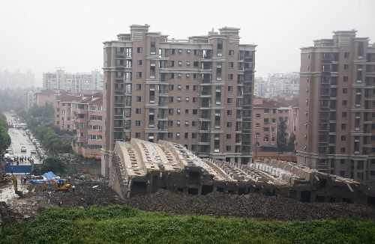
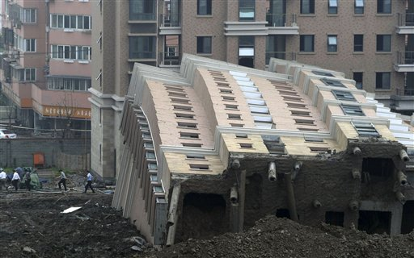
Bearing Capacity Failure
.. of a 13-story building in China in 2009.

Slide 16
Bearing Capacity Theory
At bearing capacity failure,
Q (kN/m)
Strip Ftg
Failure surface
The soil is sheared along the failure surface.

Slide 17
Bearing Capacity Theory
Terzaghi (1943) showed that:
Strip ftg.: q_{ult} = c N_{c} + γ D_{f} N_{q} + 0.5 B γ N_{γ}
Bearing capacity factors
Square ftg.: q_{ult} = 1.2 c N_{c} + γ D_{f} N_{q} + 0.4 B γ N_{γ}
Circular ftg.: q_{ult} = 1.2 c N_{c} + γ D_{f} N_{q} + 0.3 B γ N_{γ}

Slide 18
Bearing Capacity Theory
N_{q} = e^{π tanφ} tan² (45 + φ/2)
N_{c} = (N_{q} – 1) cotφ
Several expressions proposed for N_{γ}.
Meyerhof: N_{γ} = (N_{q}-1) tan(1.4φ)
Hansen: N_{γ} = 1.5(N_{q} – 1) tanφ
Eurocode 7: N_{γ} = 2(N_{q} – 1) tanφ

Slide 19
Modified Bearing Capacity Theory
For any footing shape,
q_{ult} = c N_{c} + γ D_{f} N_{q} + 0.5 B γ N_{γ}
Correction factors to account for:
Shape (s) ➔s_{c}, s_{q}, s_{γ}
Depth (d) ➔d_{c}, d_{q}, d_{γ}
Load inclination (i) ➔i_{c}, i_{q}, i_{γ}
Ground inclination (g) ➔g_{c}, g_{q}, g_{γ}
Base inclination (b) ➔b_{c}, b_{q}, b_{γ}
Proposed by Meyerhof (1963), Hansen (1970), Vesic (1973)

Slide 20
Settlement of a Shallow Foundation

Slide 21
Settlements
Beam
Span length = L
Settlement =δ₁
Settlement =δ₂
Differential settlement = |δ₁-δ₂|
Angular distortion= |δ₁-δ₂| ÷ L
Large angular distortion can induce moments and cause severe distress to the structure .

Slide 22
Settlements
Limiting values of angular distortion: 1/150 … for structural damage 1/300 … for architectural damage
Limit the total settlements (δ₁, δ₂) to limit the differential settlements.
e.g., Total settlements of shallow foundations in granular soils is generally limited to 25 mm.

Slide 23
Sands vs clays
q (kPa)
q (kPa)
GL
GL
Granular soil
Cohesive soil
Secondary compression settlement (s_{s})
With slight increase with time due to creep?
Settlement
Settlement
Consolidation settlement(s_{c})
Immediate settlement (s_{i})
Time
Time

Slide 24
Settlements in granular soils
Applied pressure (q)
Soil stiffness (E)
Settlement = f
Footing width (B)
Footing shape (B/L)=0~1
Footing depth (D_{f}/B) = 0~1
Measured by N or q_{c} from standard/cone penetration tests.

Slide 25
Settlements in Granular Soils
Several methods to predict settlements:
Terzaghi & Peck (1967) Method
Schmertmann et al. (1970, 1978) Method
Burland & Burbidge (1985) Method
Mayne & Poulos (1999) Method
Many others…

Slide 26
Terzaghi & Peck Method
q
B (m) × B (m) footing
q
0.3 m square plate
GL
GL
Settlement = δ_{plate}
Settlement = δ_{footing}
Plate Load Test
Footing (Prototype)
From graph (Next slide)
Depth correction factor

Slide 27
Terzaghi & Peck Method
Read off δ_{plate} from this graph.

Slide 28
Schmertmann et al. Method
q
GL
0.6
I_{z}
0.1
I_{z}
0.2
B
z
½B
½B
Square
B
2B
2B
Strip
1970
z
1978
4B
z
σ′_{v0} at depth where I_{z,peak} occurs

Slide 29
Schmertmann et al. Method
q
GL
0.6
I_{z}
B
z
½B
2B
1970
z
E = 2 q_{c}
Same I_{z} for all footing shapes

Slide 30
Schmertmann et al. Method
q
GL
0.1
I_{z}
0.2
B
z
½B
Square
B
2B
Strip
1978
4B
z
E = 2.5 q_{c} for axisymmetric loading & 3.5 q_{c} for plane strain loading.

Slide 31
Schmertmann et al. Method
Two correction factors C₁ & C₂:
Overburden (or Stress relief): C₁ C₁ = 1-0.5 (σ′_{vo})/q ≥ 0.5
Time (or Creep): C₂ C₂ = 1 + 0.2 log (t/0.1)
t = time (years) since loading

Slide 32
Burland & Burbidge Method
Based on 200+ settlement records of prototype foundations ➔ Semi-empirical
Uses average blow count, not corrected for depth
q (kPa)
Average coefficient of vertical compression, defined as:
z_{I}
z_{I} (m) = B^{0.7}(m)

Slide 33
Burland & Burbidge Method
Compute settlements by δ = q m_{v} z_{I}
If Normally Consolidated:
If Overconsolidated & q < σ′_{p} :
If Overconsolidated & q > σ′_{p} :
σ′_{p}
q

Slide 34
Burland & Burbidge Method
For non-square footings, multiply δ by:
If depth to stiff stratum (H) is less than z_{I}, multiply δ by:

Slide 35
Burland & Burbidge Method
To account for creep, multiply δ by: 1 + R₃ + R_{t} log (t/3)
0.3-0.7
0.2-0.8
settlement
δ
3 yrs
time

Slide 36
How good are these methods?
Quite poor
Generally overestimate the settlements and thus underestimate the allowable pressure
Therefore, it is good to carry out a probabilistic assessment (see next slide)

Slide 37
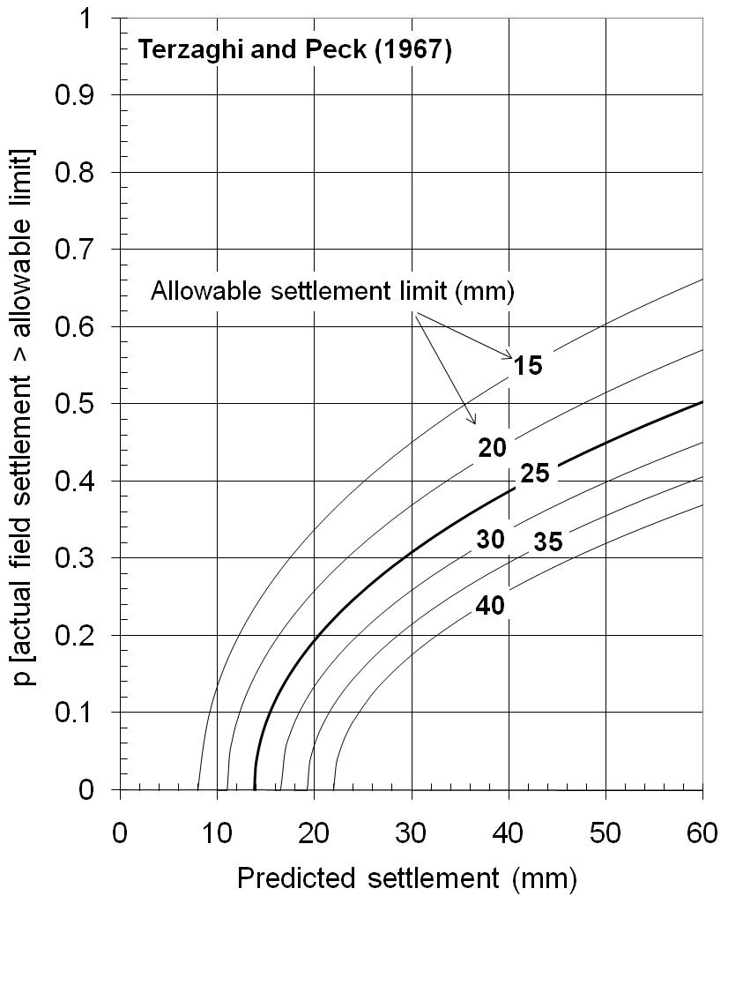
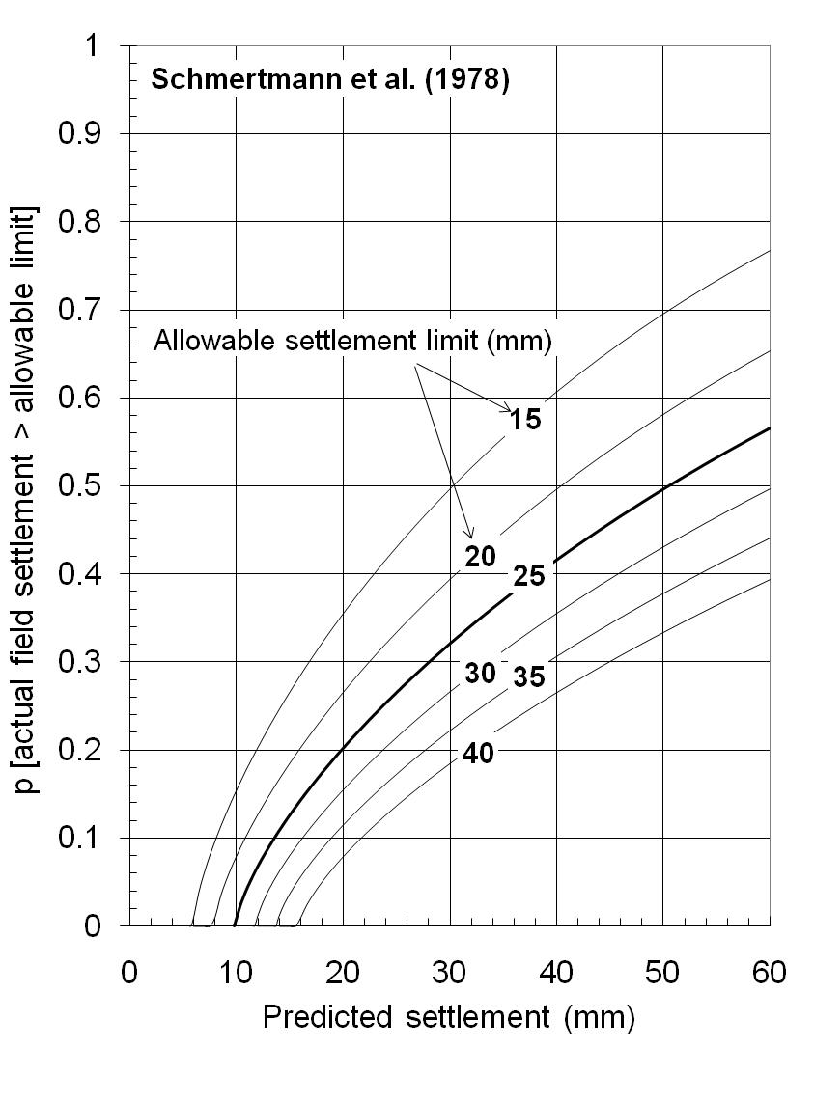
Settlements – A Probabilistic Approach
Sivakugan & Johnson (2004) - Geotechnique

Slide 38
Design Charts in Granular Soils
Footing
Bearing capacity criterion (F > 3)
Settlement criterion (δ < 25 mm)
F < 3
δ > 25 mm
Allowable pressure
Allowable pressure
F > 3
δ < 25 mm
Footing width
Footing width

Slide 39
Design Charts in Granular Soils
For N₆₀ = 35,
Allowable pressure
F > 3 & δ < 25 mm
Footing width

Slide 40
Design Charts in Granular Soils
Allowable pressure
N₆₀ = 50
N₆₀ = 30
N₆₀ = 10
Footing width

Slide 41
The End

