Slide 1
Pile Foundations
Bearing capacity and Settlement
Duration: 13 minutes

Slide 2
Introduction
- Applications of deep foundations

Slide 3
Deep foundations
Deep foundations have depth (D_{f}) greater than the breadth (B).
Often significantly greater – with l/d as high as 50
d (pile diameter)
l (pile length)
Pile cap
l
Single Pile
Pile Group
d

Slide 4
Applications
To carry large column loads where shallow foundations are inadequate;
to carry column loads when the ground conditions are poor;
to carry lateral loads;
to resist uplift loads; and
to improve existing foundations (e.g., underpinning).

Slide 5
Applications
Wind load
Tie rod
Anchor
Batter piles
Provides anchorage against uplift
Pile in tension
Pile in compression
Sheet pile
Transmission tower
Anchored sheet pile
Underreamed pile

Slide 6
Applications

Slide 7
Pile materials
Timber
Low capacity (< 500 kN)
Decays in fluctuating water table
Concrete
Precast (reinforced or prestressed)or cast-in-place (nominal reinforcement)
Larger capacity (e.g., 7000 kN)
Steel
Large load carrying capacity
Install by driving; high resistance to driving
Install by driving
Easy to splice
Composite
Can include more than one of the above three materials
Can be made of Fiber Reinforced Polymers (FRP)

Slide 8
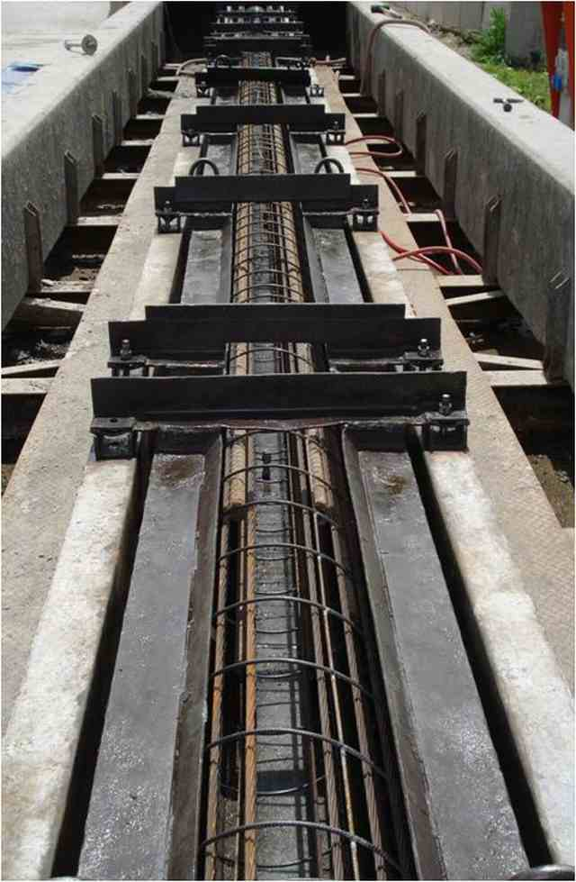
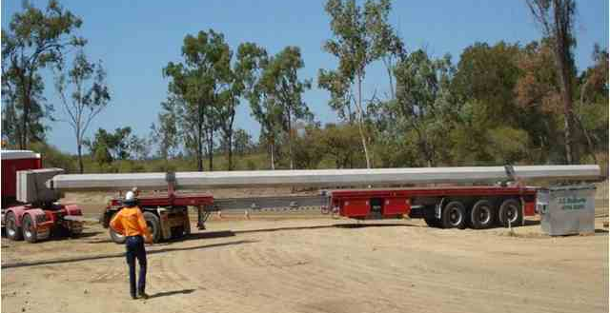
Precast piles
Mostly driven
Requires storage yard and transport to the site
Splicing possible, but not desirable

Slide 9
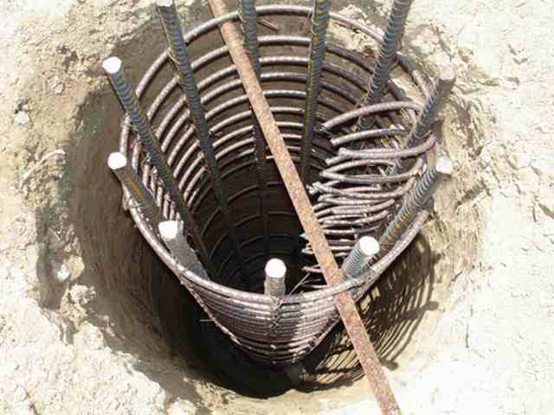
Cast-in-place piles
Also known as bored piles

Slide 10
Bearing Capacity
- Single Pile

Slide 11
Load carrying capacity of a single pile
Pile load (Q) is carried by the shaft (Q_{shaft}) and the tip (Q_{tip})
Pile load (Q)
Q = Q_{shaft} + Q_{tip}
At failure,
Q_{ult} = Q_{shaft,ult} + Q_{tip,ult}
Q_{shaft}
Q_{tip}
Pile length = l
Pile diameter = d

Slide 12
Load carrying capacity of a single pile
Q_{tip,ult} = q_{tip,ult} A_{tip}
Pile load (Q)
Tip load
Tip area
z
Ultimate bearing capacity at tip
f_{s}
Shaft load
Perimeter
q_{tip,ult}
Skin friction/adhesion
Pile length = l
Pile diameter = d

Slide 13
End bearing vs. friction piles
End bearing pile:
Friction pile:
Weak soil (e.g. soft clay)
Stiff stratum
Entire column load is transferred through the pile tip
Entire column load is transferred through the pile shaft
Q_{shaft} = 0
Q_{tip} = 0

Slide 14
Tip bearing capacity
In granular soils,
q_{tip,ult} = γ l N_{q} + 0.5 d γ N_{γ}
N_{q} and N_{γ} are of the same order, and
l >> 0.5d
l
∴q_{tip,ult} ≈ γ l N_{q}
f(φ) – bearing capacity factor
Berezantsev et al.
Terzaghi
Meyerhof
Others
d

Slide 15
Tip bearing capacity
In cohesive soils, under undrained conditions (φ_{u} = 0),
q_{tip,ult} = c_{u} N_{c}
l
= 9 for l/d > 4
Undrained shear strength
d

Slide 16
Skin friction
In granular soils,
f_{s}(z) = K_{s}σ′_{v} tanδ
σ′_{v}
Pile-soil friction angle
z
Critical depth: d_{c} = 10-20 d
l
d
z

Slide 17
Skin friction
In cohesive soils, under undrained conditions (φ_{u} = 0),
f_{s}(z) = α c_{u}
z
l
Adhesion factor (< 1)
d

Slide 18
Pile driving equations
Principle:
Hammer weight = W
Drop = h
Work done per hammer blow:
Q_{ult}
W h η = Q_{ult} s
Hammer efficiency
Set
Ult. Bearing capacity (load)
Set is the penetration of the pile into the ground per blow.

Slide 19
Pile driving hammer
Ram
Anvil
Drop Hammer
Free fall of hammer – raised by hoist
Old fashion and simple
Single/Double acting hammer
Uses air or steam
Single acting – compressed air used for upstroke
Diesel Hammer
Combustion of fuel at the end of downstroke that pushes the hammer up,
Double acting – comp air used for up/down strokes
Cap block (Hammer cushion)
Pile cap
Pile cushion
Pile

Slide 20
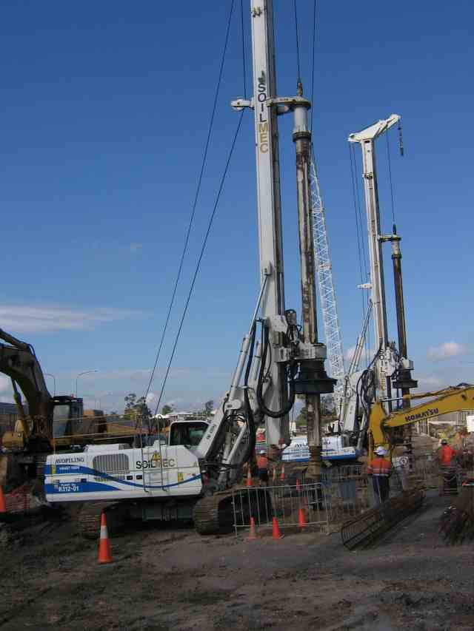
Pile driving

Slide 21
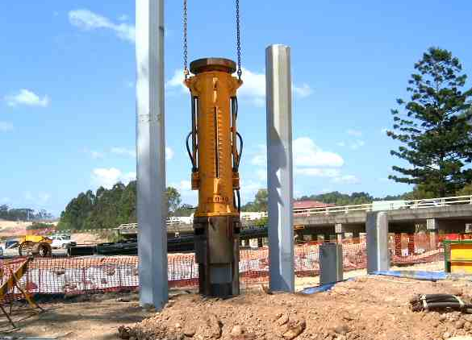
Pile driving

Slide 22
Pile driving

Slide 23
Vibratory pile drivers

Slide 24
Load transfer mechanism
Q
Load
Reached at small settlement of 6-10 mm
Q_{shaft}
Q_{shaft}
Settlement
Q_{tip}
Q_{tip}
Shaft resistance is fully mobilised well before the tip resistance.

Slide 25
Settlement
- Single Pile

Slide 26
Settlement prediction
Settlements are relatively small in piles; Not as serious as in shallow foundations.
About 1% of the pile diameter under working loads.
May add the elastic shortening of the pile to the above.
Two methods: (a) Poulos & Davis (1974) (b) Vesic (1977)

Slide 27
Elastic shortening of a pile
Q
Q
A
l
l
Q_{shaft}
Q
Q_{tip}
Due to skin friction, pile load decreases with depth.

Slide 28
Elastic shortening of a pile
Under working loads,
Elastic shortening of the pile is (Vesic, 1977):
Q_{w}
l
Q_{ws}
0.50-0.67, depending on how the skin friction (f_{s}) varies with depth.
f_{s}
f_{s}
f_{s}
f_{s}
Q_{wt}
ξ=⅔
ξ=⅔
ξ=½
ξ=½
z
z
z
z

Slide 29
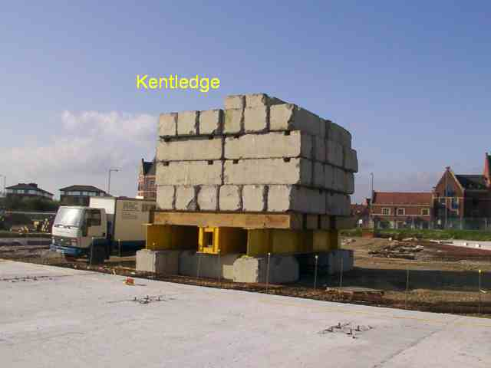
Pile Load Test
To determine the actual load carrying capacity of a few randomly selected piles.
A simpler alternative is to use a Pile Driving Analyser (PDA) – Next slide.

Slide 30
Pile Driving Analyser (PDA)
Gives hammer energy, driving stresses, pile integrity and bearing capacity.
Can use on bored piles too – by measuring the pulse from a drop weight.

Slide 31
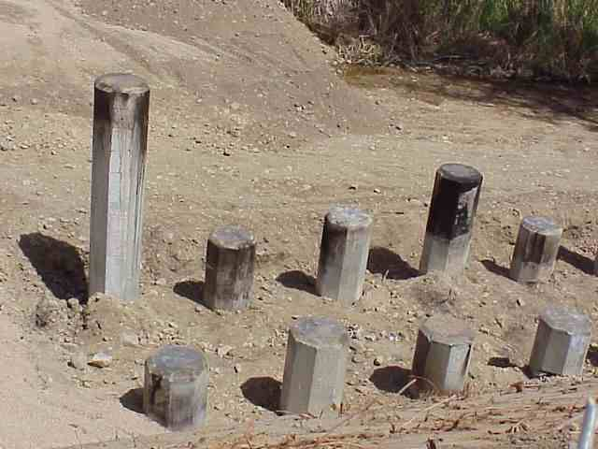
Pile Groups
- To carry large column loads
Before the pile cap is cast

Slide 32
Pile Group
Q_{ult, pile group} = Q_{ult, single pile} × No. of piles × η
Efficiency of the pile group (< 1)
Pile cap
Pile groups

Slide 33
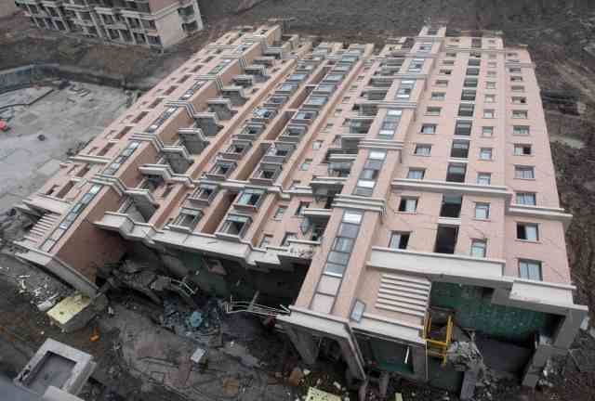
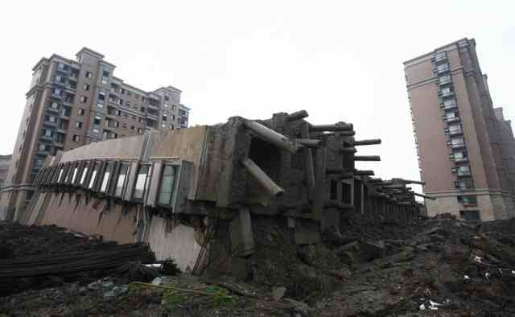
Failure: A Costly lesson
A newly built, 13 storey apartment complex collapsed in Shanghai on 27th June 2009, during the final stages.

Slide 34
Thank You
Some of the photographs in this presentation were provided by:
Dr Warren Ng, Dynamic Pile Testing
Ms. Mary Balfour, Balfour Consulting
Mr. Martyn Ellis, PMC Limited, UK
Mr. Jesse Brunskill, Civil, Mining & Construction Pty Ltd.

